Slide 1
Better Together lunch update
Ben Irving

Slide 2
Overview
Embedding strategies
Evaluation
Academic recommender system: How can we find relevant reviewers, and papers to cite?

Slide 3
The citation graph
Papers can be seen as nodes in a graph:
Paper 1 =
Paper 2 =
Paper 3 =
Papers cite each other. If Paper 1 cites Paper 2 and Paper 2 cites Paper 3, the resulting ‘citation’ graph:
1
2
3
1
2
3

Slide 4
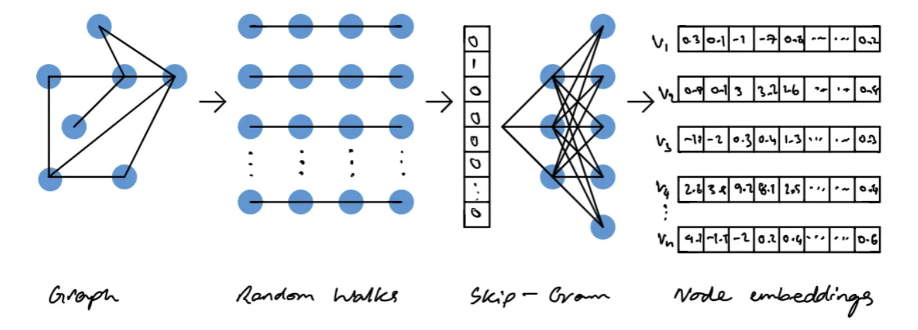
Can we create embeddings from this input?
Turn the graph to vectors (photo courtesy of Vatsal https://towardsdatascience.com/node2vec-explained-db86a319e9ab)
These can be layered on top of other models, such as BERT, to compute stuff.

Slide 5
Embedding Strategies that we are exploring:
Linear Algebra
ProNE
Deep nets:
GNNs
Other models (Specter, Scibert, etc.)

Slide 6
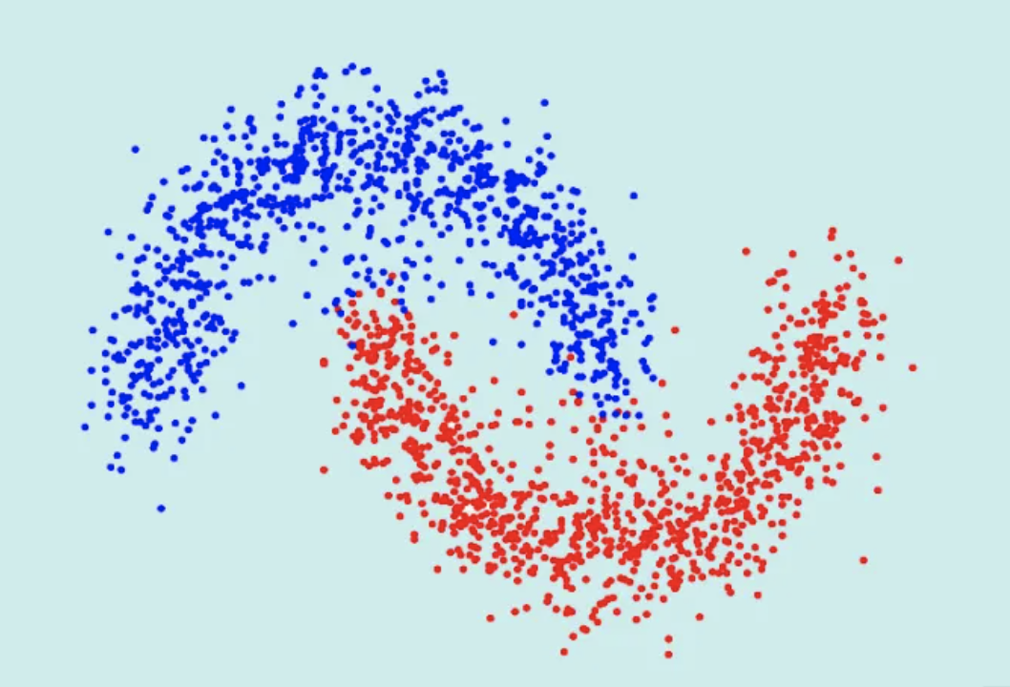
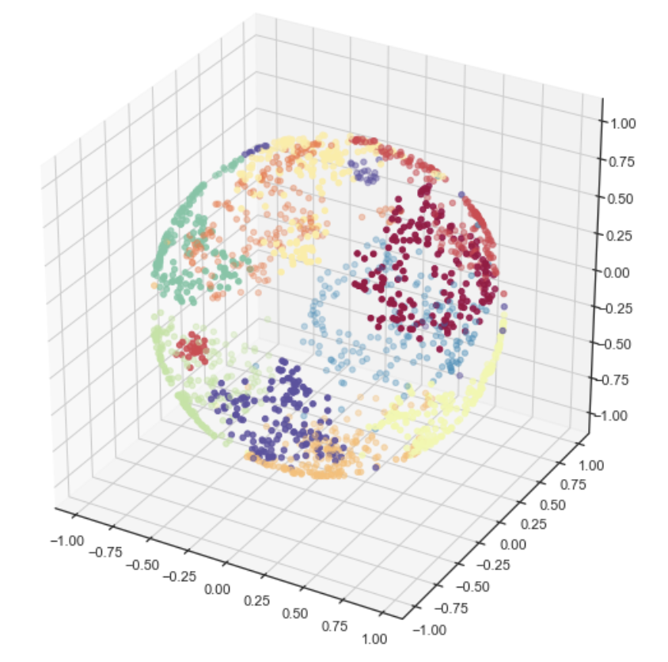
Hallowed tradition…
ProNE
x 14
Spectral Clustering
tSVD
SVD
K
N
Embeddings
Notes:
Images courtesy of:
https://datascientest.com/spectral-clustering

Slide 7
What do we want to extract:
What are the relationships between vectors in this input matrix? Are there any? Can we encode that in our output?
So:
extract local graph info
And Global info:
This is a paper! (node in the graph)
[0, 0.3, …. 0.3135]
Change this, to encode relationships in that
[0, 0.3, …. 0.3135]

Slide 8
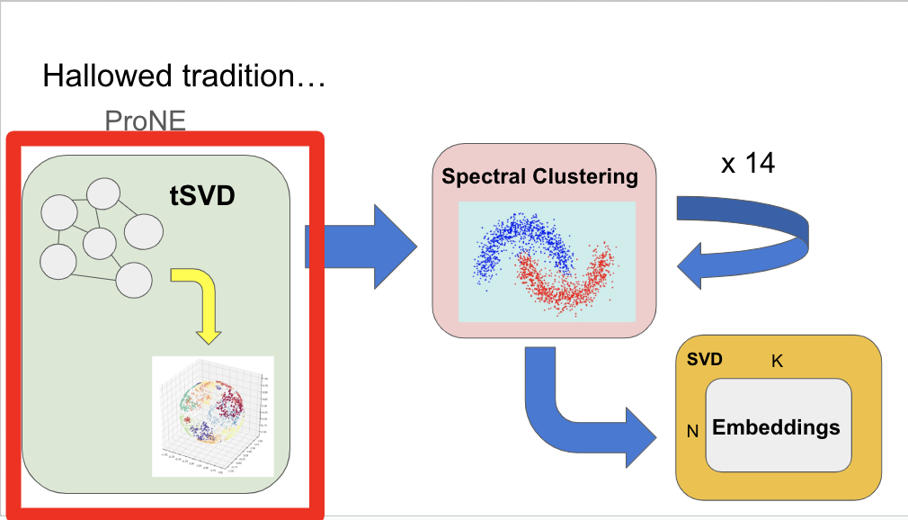
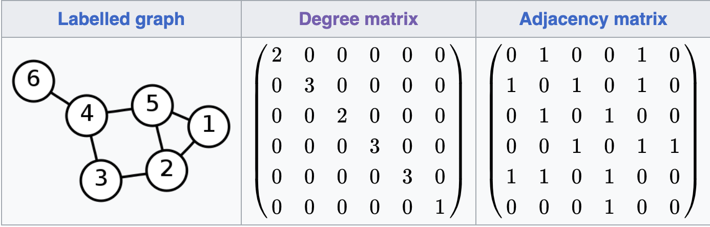
Prefactor Step

Slide 9
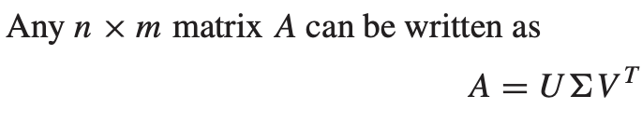
SVD (Singular Value Decomposition)
(The fundamental theorem of linear algebra)
Eigen decomposition
left orthonormal eigenbasis of the transformed input data, scaled by the singular values,
the singular values
the right orthonormal basis of the original vector space

Slide 10
For ProNE
More specifically: randomized truncated singular value decomposition
(alterations to make the algorithm run more efficiently)
Our output is representative of the multiplication between the first two matrices
But in essence:
We want to effectively extract a vector representation by decomposing the original matrix, and tSVD does well to extract singular values from a matrix representing local connections in the input graph. The transformed input graph maps relationships between nodes which are one step apart in the original citation graph.

Slide 11
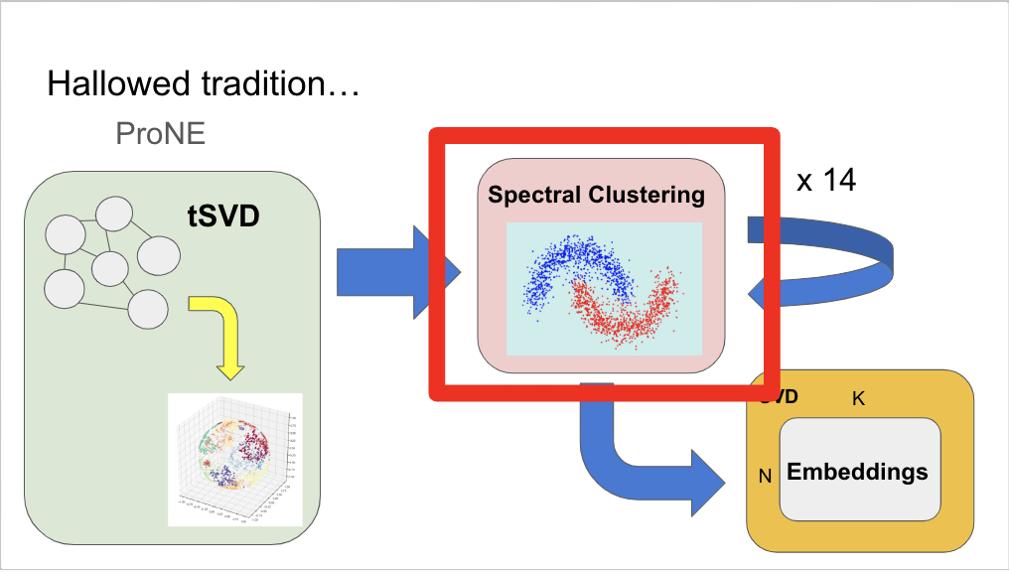
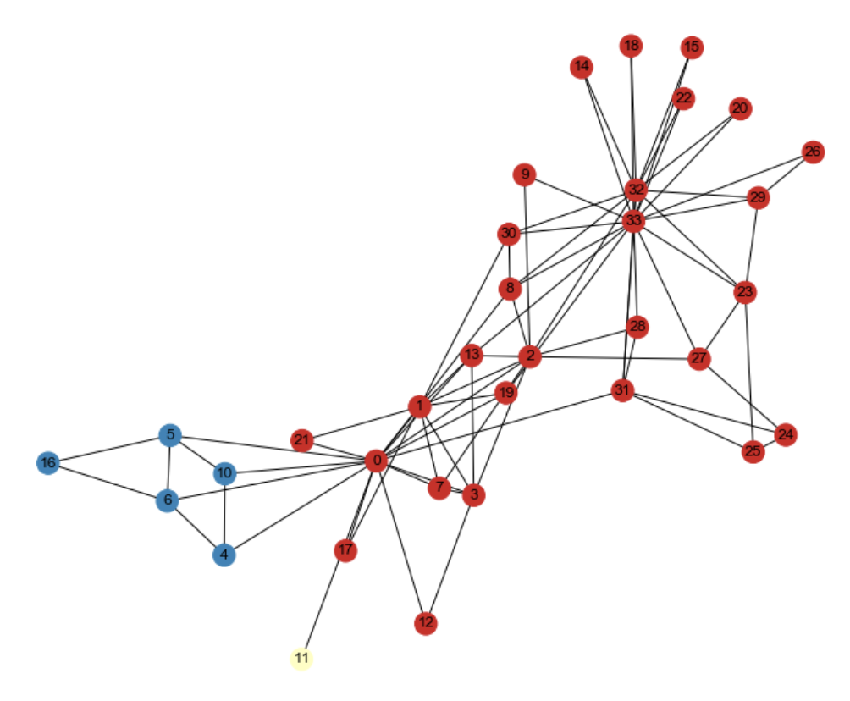
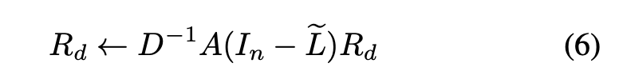
Spectral Clustering (Chebyshev iterations)
What about the graph as a whole?
We want to encode groupings +
patterns into our embeddings.
This is done with a whole bunch of complicated
math. But this is the general idea.

Slide 12
Limitations
Limited space (<= 2 TB per job)
Limited time (<= 1 day per job)
Without dividing code: 2 TB of memory, 3.8 days
Prone.py
Notes:
Ben Talk
Without dividing up file: computation on full graph partition will take 9.8 TB of memory, and will run over 92.2 hours (3.8 days)

Slide 13
Model and limitations
Limited space (<= 2 TB per job)
Limited time (<= 1 day per job)
Without dividing code: 2 TB of memory, 3.8 days
Prefactor
Prone.py
Chebyshev
Finish step

Slide 14
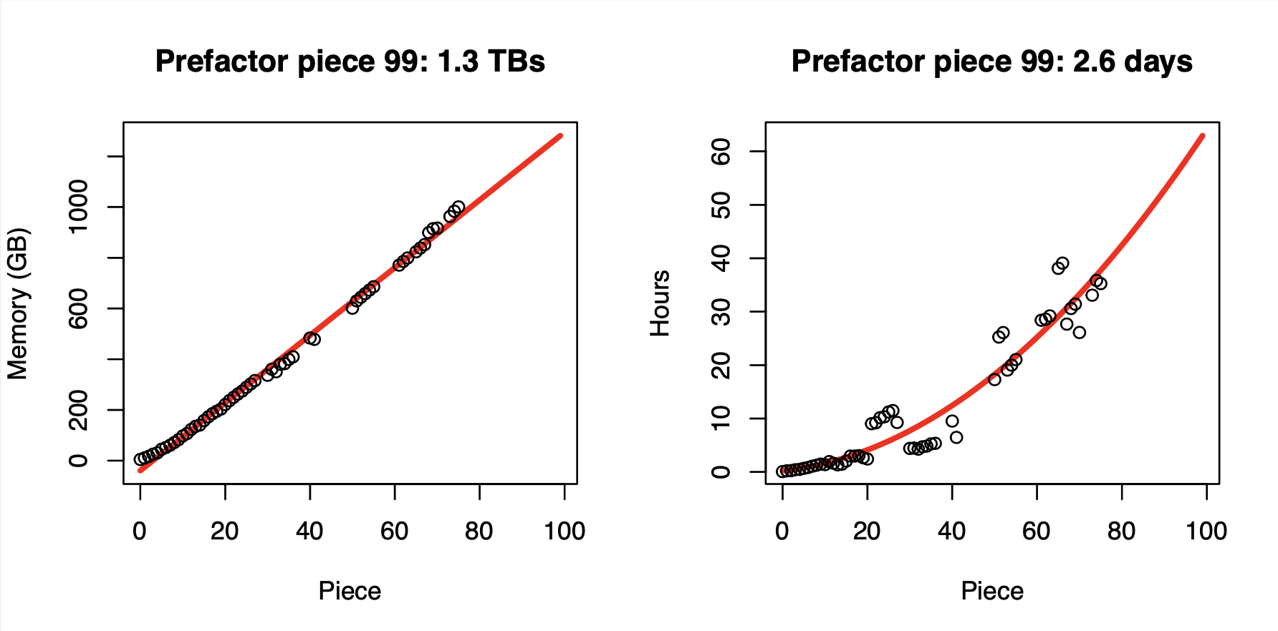
Prefactor Step
We are all not equal under the time constraint laws…
Graph Partition
Graph Partition

Slide 15
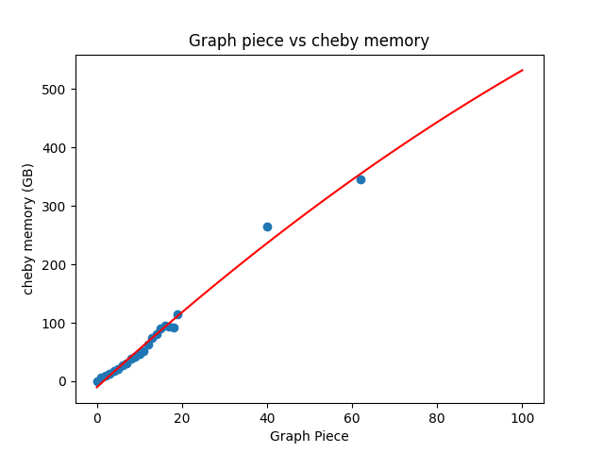
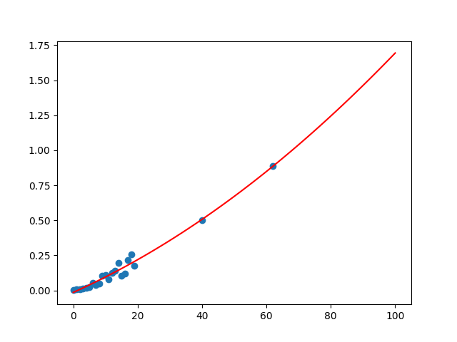
Chebyshev step (1 iteration) - what I CAN run
Memory vs Graph Part - 532GB
Time vs Graph Part 1.69 hours
Time (H)
Memory (GB)
Graph Partition
Graph Partition
Notes:
Chebyshev memory utilization: 1 iterations, will take 532 GB of memory
Piece
Full graph time projection: 1.69 Hours per step (1 hr 41 minutes)

Slide 16
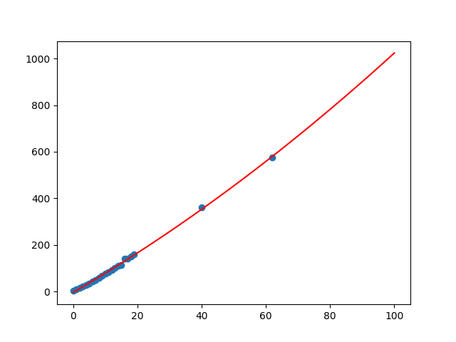
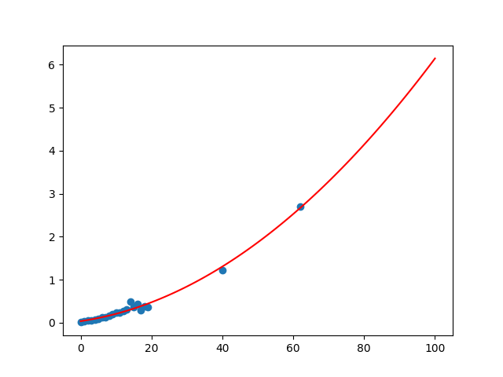
Finish step - what I CAN run, within constraints
Graph Part vs Memory - 1TB
Graph Part vs Time - 6.14 Hrs
Memory (GB)
Time (H)
Graph Partition
Graph Partition
Notes:
Finish memory utilization for full graph: 1 TB (or thereabouts)
Finish time to run: 6.14 hours

Slide 17
To parallelize, or not to parallelize
GPUs are faster (even for SVD)
And, torch.sparse (cuSparse) is good (for the chebyshev iterations)
BUT

Slide 18
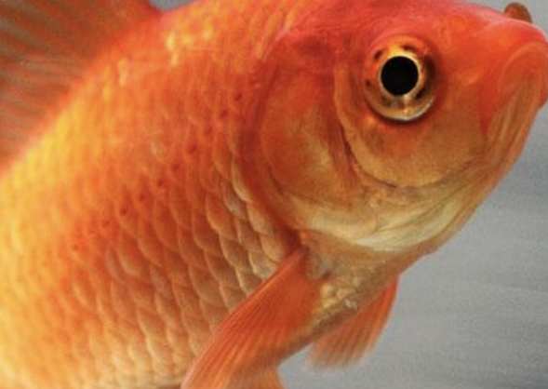
To parallelize, or not to parallelize
GPUs are faster (even for SVD)
And, torch.sparse (cuSparse) is good (for the chebyshev iterations)
BUT
GPU memory
The importance of parallelization falters…
We have already seen 10 % time increases in the chebyshev step
(At least at Northeastern)
Notes:
On v100 with 1% of graph:
We shave 10% of time on the chebyshev matrix multiplications (negligible gains)
speedups would scale quickly with the matrix size

Slide 19
Next Steps
Optimize further (cython, more pytorch, and dax)
Resolve hunches, combine work.
Build a useable system.
Notes:
Ben Talk

Slide 20
GNNs: Another strategy (Sandeep and Hui)
Citation Graph
Node Features (Text)
GNN Encoder
Combined Features (Context + Text)

Slide 21
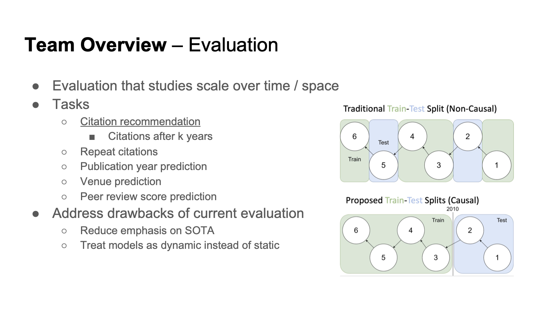
The GNN
Slide courtesy of Melissa! Figures are from Peter.
Melissa, Shabnam, Abteen, Peter
Another strategy: Use a graph neural network
Notes:
Update:
We want to predict links (LINK predictions)
We know the references for q, we withhold some k of those references for a test set and then compute the vectors we didn’t withhold to look in some previous bins, and see if the withheld are predicted (meaning they have high cosine values)
And we want to have a temporal understanding of the paper. How has its relationships and relevance evolved over time.
Measure the variance of cosine similarities between papers.

Slide 22
The big picture
We want to build a usable system
Paper ID:
Related work
Reviewers?
Notes:
More importantly: The embeddings should be good enough for OTHER people’s systems as well.

Slide 23
Conclusion
Our embedding strategies are making progress
(We have finished 40 graph pieces for Prone, and the GNN team is readying their code for the semantic scholar graph)
Evaluation (finalizing metrics, and readying experiments)
The larger system:
Our Amazon credits are coming soon (hopefully can launch a simple web server)
When embeddings are complete, we will distribute them!

